Slide 1
Unit 5:Sequential Circuits
Basic sequential circuits
SR-latch
Basic sequential circuits
SR Flip Flop
Basic sequential circuits
Master Slave JK flip flop
Basic sequential circuits
D-latch
D Flip Flop
Basic sequential circuits
Conversion of basic flip-flop
JK Flip Flop
T Flip Flop

Slide 2
Today’s Highlights
Sequential Circuits
Latch
SR Latch

Slide 3
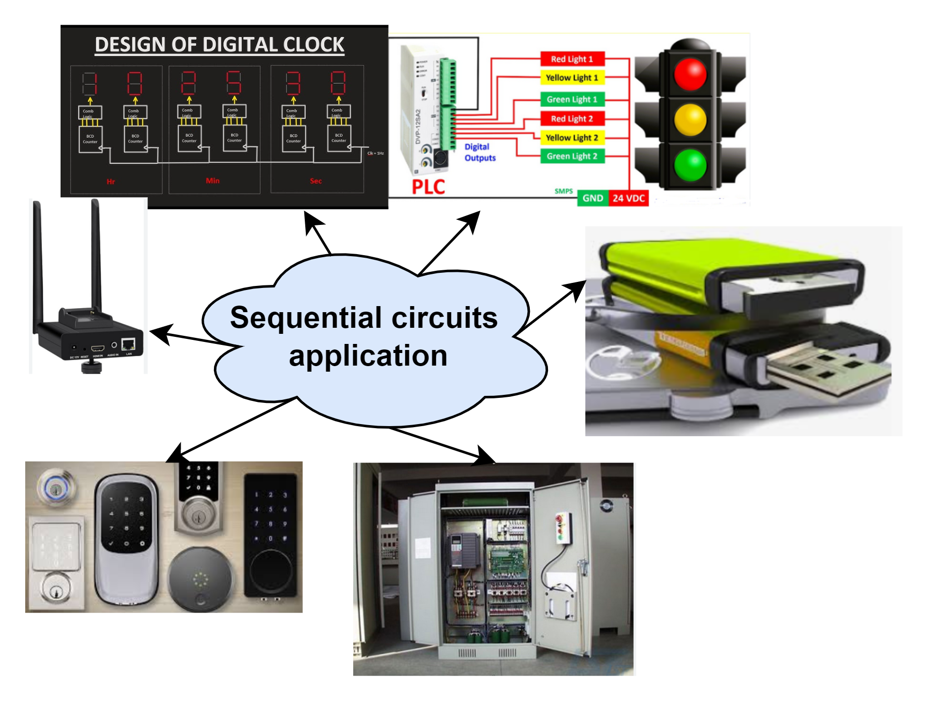

Slide 4
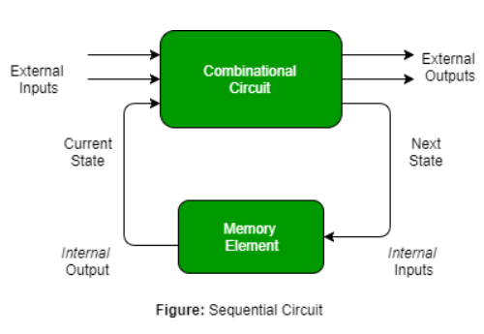
Sequential circuits

Slide 5
Difference between Combinational and Sequential Circuits
Combinational Circuits | Sequential Circuits
The output depends only upon the present inputs | output depends not only on the present inputs, but also on the previous output
No feedback | Feedback available from output to input
No ability to store | Ability to store
Easier to design, use and handle | not easier to design, use and handle
No clock signal | Clock signals are required for triggering purposes
Faster | slower than combinational circuits
Elementary building block: Logic gates | Elementary building block: Flip flops
Examples: Adder, Subtractor, Magnitude comparator, Multiplexer, Decoder, etc. | Examples: Latches, flip flops, counters, registers,etc.

Slide 6
QUICK QUIZ (POLL)
Which of the following is NOT the combinational circuit?
magnitude comparator
multiplexer
Decoder
Flip flop

Slide 7
Latches
SR Latch
D Latch
SR LATCH with NAND Gate
SR LATCH with NOR Gate
D LATCH with NAND Gate
D LATCH with NOR Gate

Slide 8
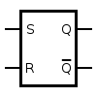
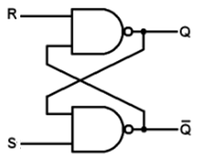
SR NAND latch
Step 1: Block Diagram
Step 2: Circuit Diagram
Step 3: Truth Table
Case1:
S= 0,R=0
S | R | Q | Q
0 | 0 | Invalid
0 | 1 | 0 | 1
1 | 0 | 1 | 0
1 | 1 | No Change

Slide 9
Case2: S=0, R=1
Case3: S=1, R=0
Case4: S=1, R=1
Truth table
S | R | Q | Q’
S=0,R=0
Case1:
Case2:
Case3:
Case4:

Slide 10
QUICK QUIZ (POLL)
1.The NAND latch works when both inputs are
a) 1
b) 0 c) Inverted d) Don’t cares
2.When both inputs of NAND SR latches are low, the latch goes
a) Unstable b) Stable c) Metastable d) Bistable

Slide 11
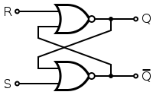
SR NOR latch
Step 1: Block Diagram
Step 2: Circuit Diagram
Step 3: Truth Table
S | R | Q | Q
0 | 0 | No Change
0 | 1 | 0 | 1
1 | 0 | 1 | 0
1 | 1 | Invalid
Case1: S=0,R=0

Slide 12
Case2: S=0, R=1
Case3: S=1, R=0
Case4: S=1, R=1
S=0,R=0
Truth table
S | R | Q | Q’
0 | 0
0 | 1
1 | 0
1 | 1
Case1:
Case2:
Case3:
Case4:

Slide 13

QUICK QUIZ (POLL)
What is the output state in SR latch at Q = 1 and $Q′$= 0
set
reset
memory
Indeterminate (invalid)

Slide 14
QUICK QUIZ (POLL)
When both inputs of NOR SR latches are high, the latch goes
a) Unstable b) Stable c) Metastable d) Bi-stable

Slide 15
SR latch Summary
SR latch (Set/Reset)can be created with two NOR/NAND gates have a cross-feedback loop
S | R | Q | Q
0 | 0 | No Change
0 | 1 | 0 | 1
1 | 0 | 1 | 0
1 | 1 | Invalid
S | R | Q | Q
0 | 0 | Invalid
0 | 1 | 0 | 1
1 | 0 | 1 | 0
1 | 1 | No Change

Slide 16

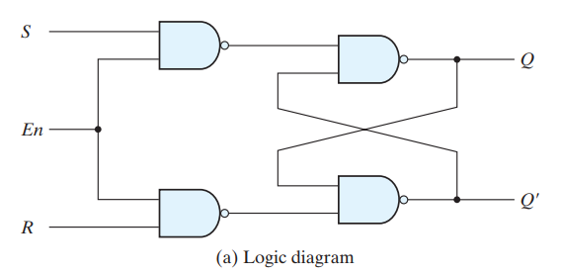
SR Latch with control input
Why Gated latch or Control Input latch??

